Slide 1
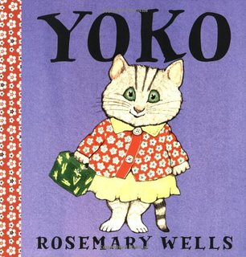
Wed. Week 3
By Monday finish:
American Born Chinese, Gene Luen Yang
To think about:
What surprised you about this week’s lectures or reading?
Do you recall a moment in childhood in which you became aware of categorizations of people or a moment in which you mistook or overapplied that categorization?
Would you share either of these books on the right with your (hypothetical, actual) child? Why/why not?

Slide 2
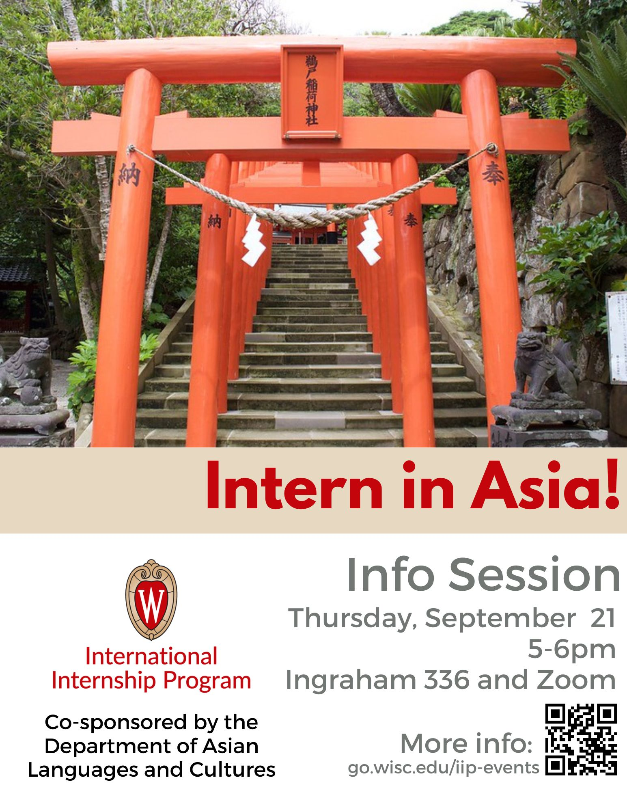

Slide 3
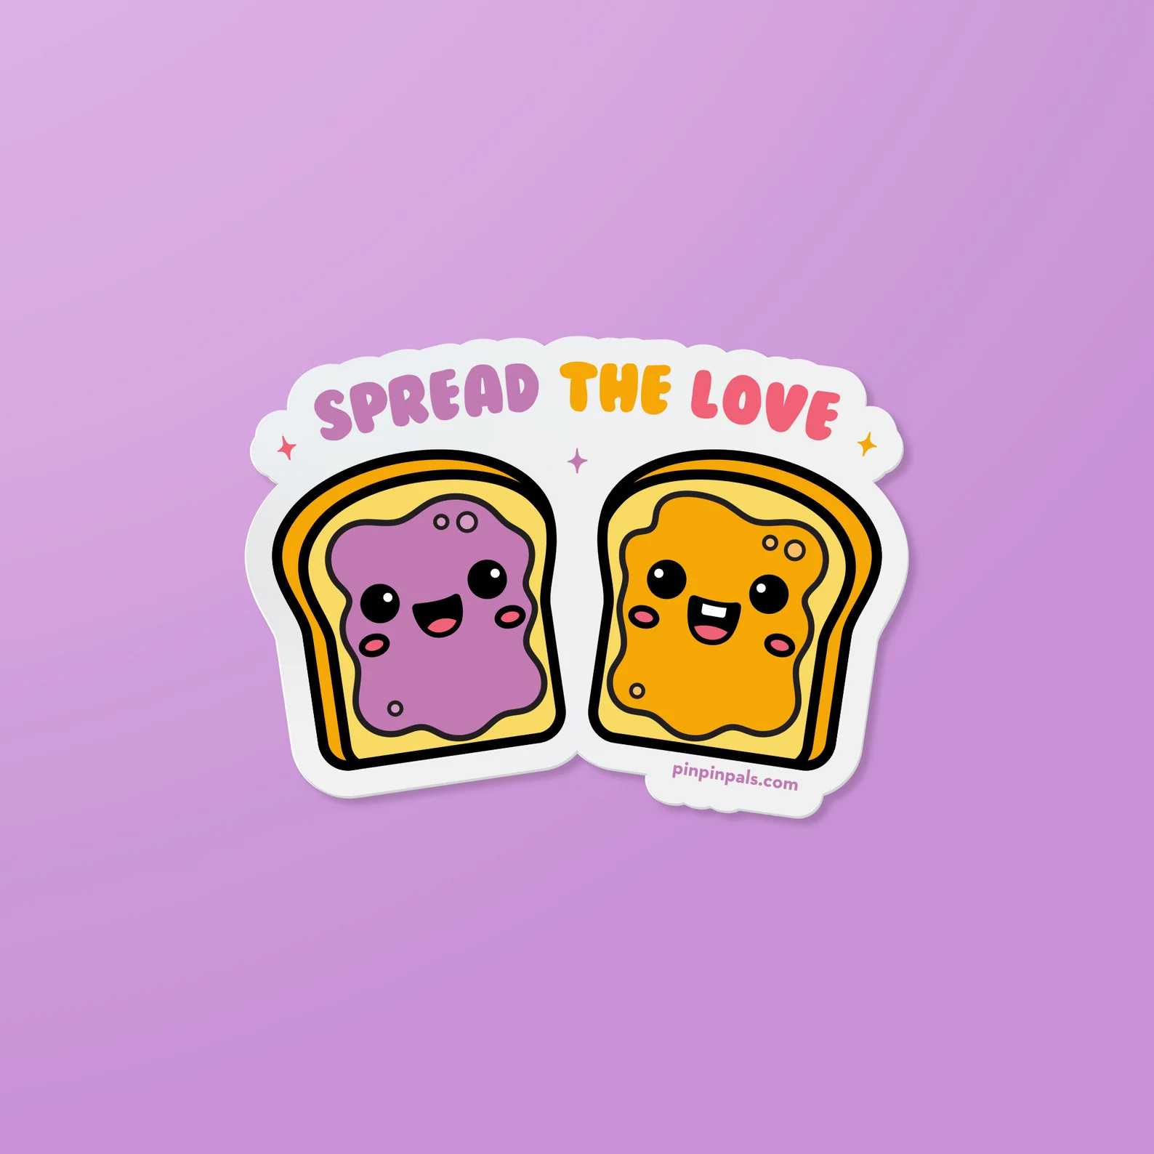
Today:
How is typing replicated?
When does race matter?
Can typing be unlearned; can racial associations be unstuck?
How can children’s and Y.A. literature contribute to the project of interrupting negative biases?

Slide 4
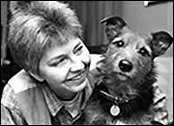
How stereotypes become replicated
The Case of the Psychic Dog

Slide 5
results of the test:
The dog went to the porch continuously, but the parents only noticed it after their daughter returned 10 min. later. Thus, they became aware of the dog’s behavior only when it confirmed their belief linking his movement to their daughter’s return.
Study revealed the power of
confirmation bias
and selective awareness or memory

Slide 6
On confirmation bias and stereotype continuation
“Confirming and Disconfirming Stereotypes” Lee and Zhou:
“[I]ndividuals have powerful, largely unconscious tendencies to remember people, events, and experiences that confirm their expectations.
[I]ndividuals often fail to see disconfirming evidence, or if they do see it, they often reinterpret it in stereotypic-confirming ways, ignore it, or dismiss it altogether as the exception” (173).
journalist Malcolm Gladwell
from Outliers: The Story of Success (2008)
“Go to any Western college campus and you’ll find Asian students have a reputation for being in the library long after everyone else has left.”

Slide 7
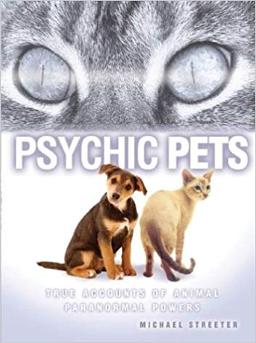
When does race “stick” to individual behavior? When is it invoked as a means of explaining an individual’s behavior?
1. “Chinese people always eat in restaurants”
2. “brown people always fight”

Slide 8
Stereotyping as a form of reductive categorization that involves
-- privileging visual differences as a means of categorization over other attributes of individuals, e.g.“naive biology”
--learning which associations “stick” to specific racial groups (environment)
--overgeneralization and transductive thinking (If . . . then . . . )
--confirmation bias and selective awareness
Comments, questions, responses?
What resonated with you in the reading or lectures for this week?
--Do you recall a moment in childhood which you relied upon any of the above to make sense of the world or misapplied a trait to a category of people or things?

Slide 9
The good news: unlearning or interrupting bias on countering racial prejudices in children developmental psychologists found that children’s biases lessened with
--familiarity with “out-group” children (e.g. learning their names, seeing them as individuals, desegregation, tools like multicultural curriculum)
--working and talking with a less biased child [interaction in classroom]
--growing up [cognitive development]
How do ADULTS unlearn racial associations applied to all members of the group? How do we delink those associations that stick to specific racial groups? How do we interrupt the belief that what applies to the individual ALSO applies to the group?

Slide 10
Would you share either of these books on the right with your (hypothetical, actual) child? Why/why not?
Foundation: How is the message in these works valuable, age appropriate, useful? What would you want your (hypothetical, actual) child to take from this work?
Complication: What’s limiting about this work from a social justice perspective?

Slide 11
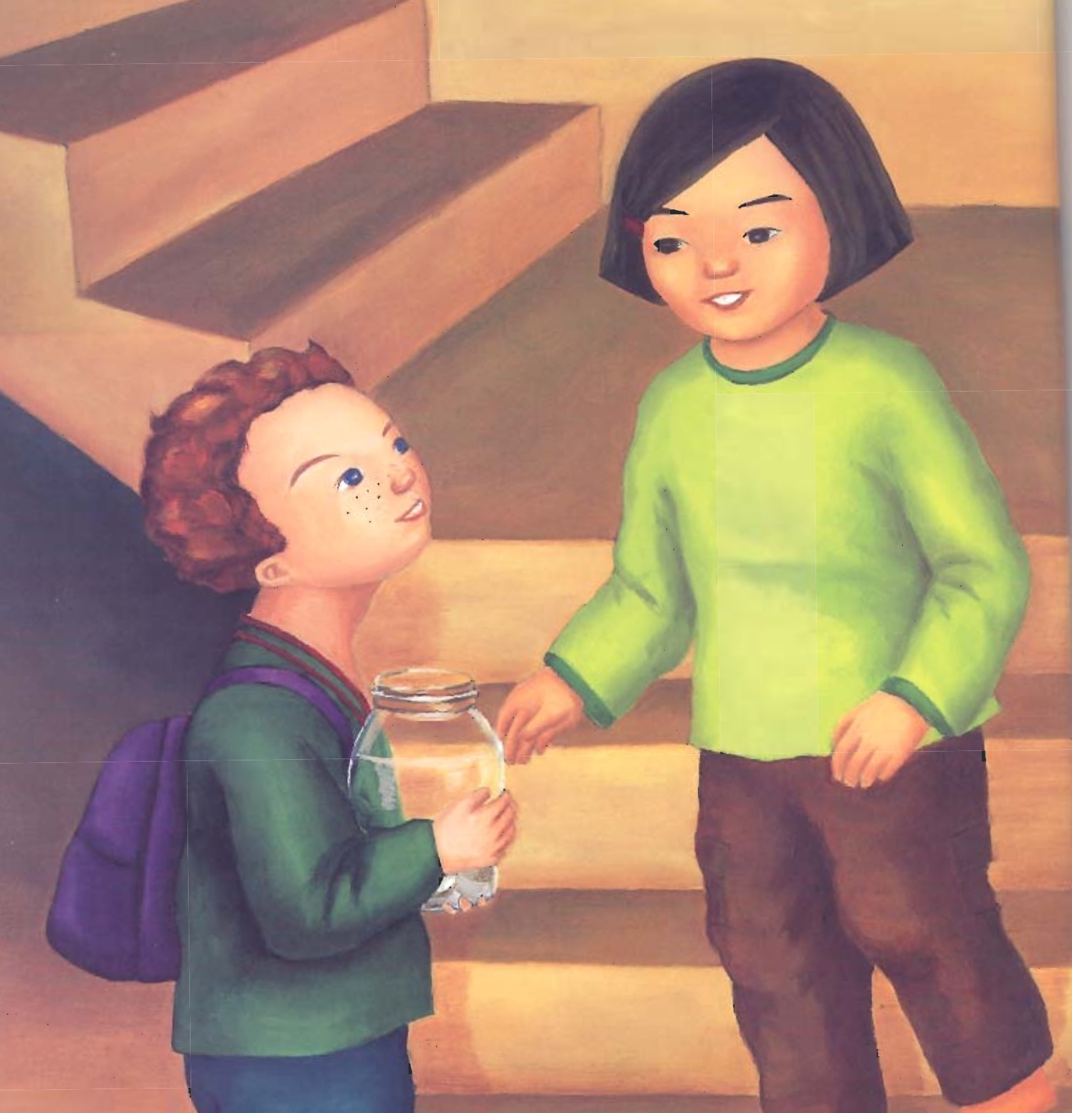
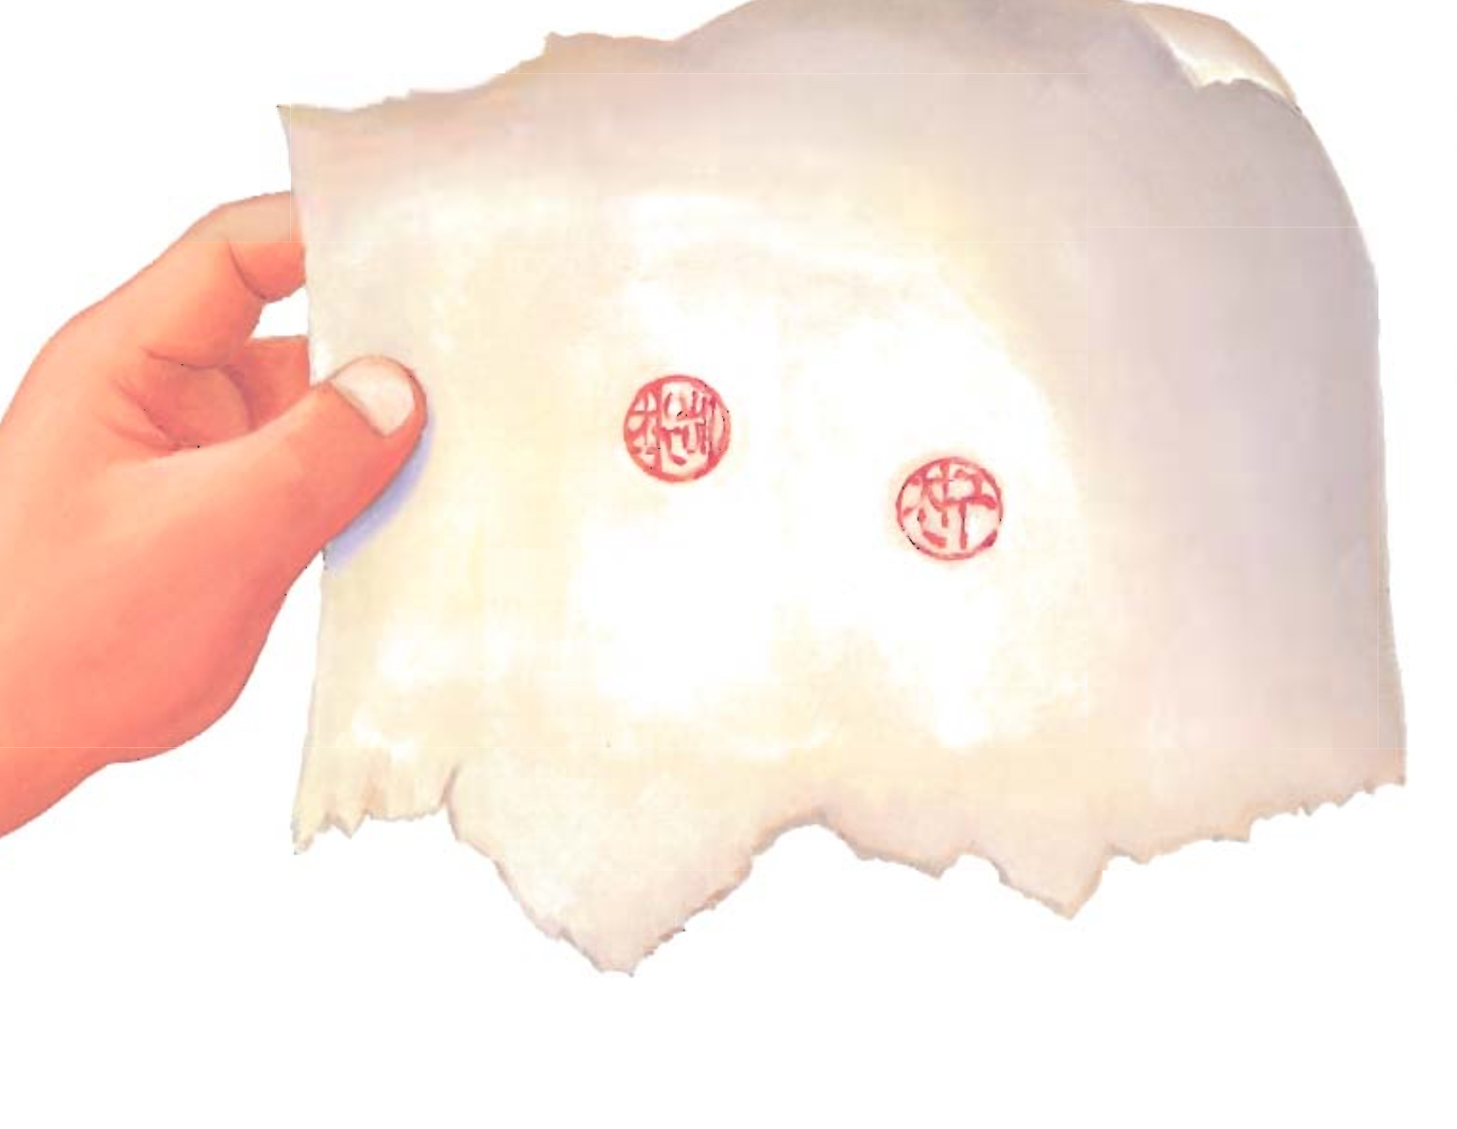
end resolution to The Name Jar:

Slide 12
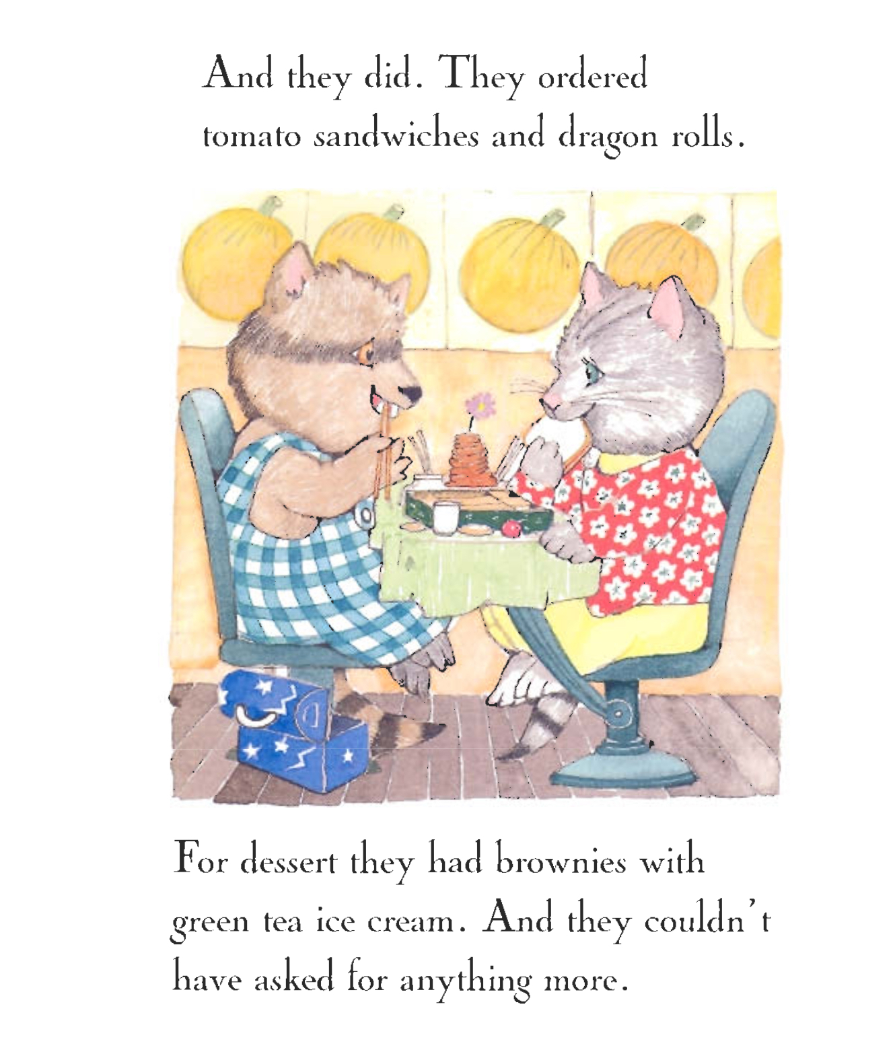
end resolution to Yoko:

Slide 13
Limitations to combatting individual prejudices as a counter to systemic bias
Eduardo Bonilla-Silva, when asked if it would be fair to have classes such as “Asian Racism” or “Latino Racism”:
“We can all be prejudiced, yeah? So, black people can be anti-white, but there is a big difference between having prejudiced views about other people and having a system that gives systemic privilege to some groups.”
author of Racism without Racists: Color-Blind Racism and the Persistence of Racial Inequality in America (2017)

Slide 14
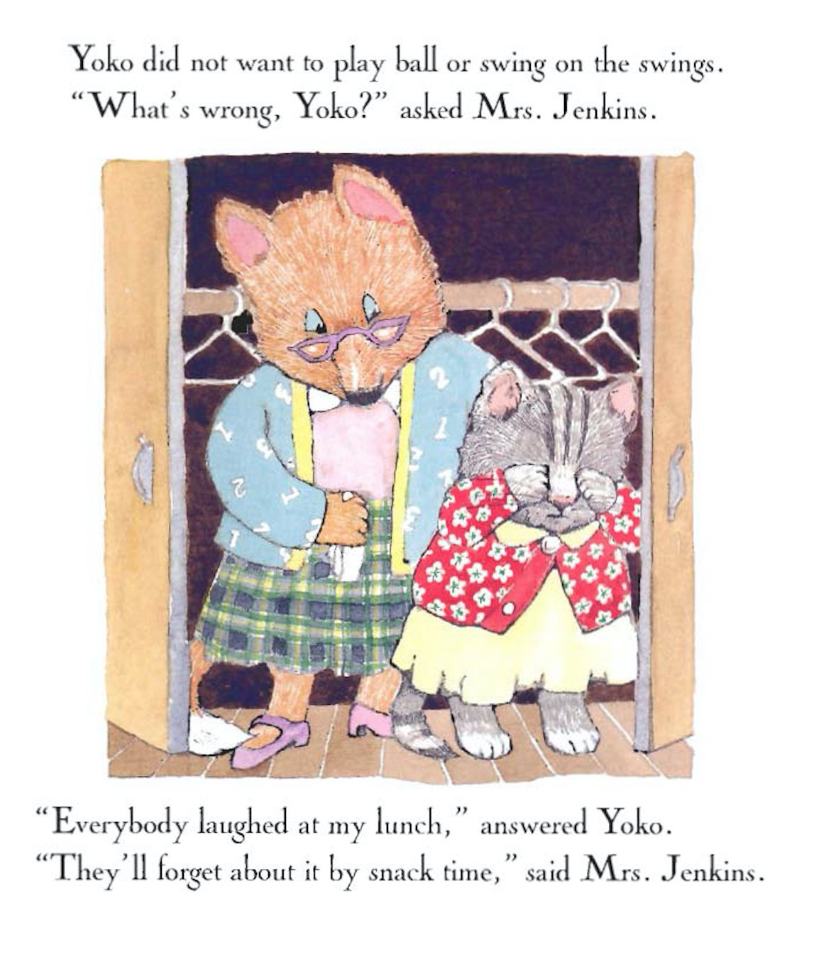
Wells’ Yoko is classified as “Juvenile Fiction, Asian American”

Slide 15
Low key fantasy: the use of species difference to model racial difference Are the progressive aims of Yoko compromised or enabled by its displacement of race-ethnicity onto animal characters? Is substituting an animal for a human (raced) person more or less effective in conveying a pro-social message?

Slide 16
Is race in this picture? Miss Bindergarten’s Kindergarten series, Slate and Wolff, 1996

Slide 17
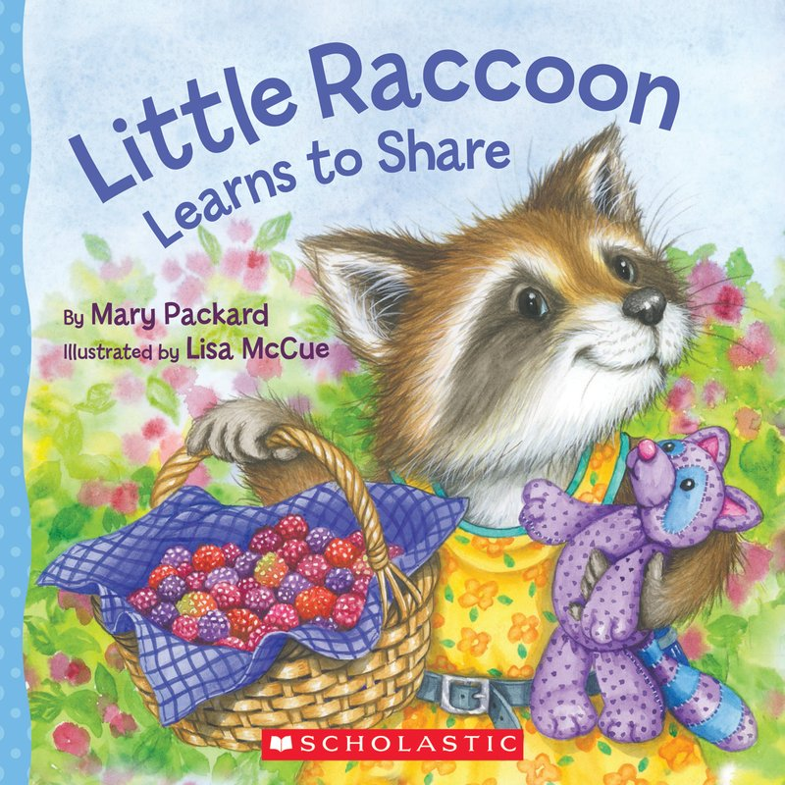
Results of a 2017 study that tested preschool children’s likelihood of sharing stickers with anonymous peers when read the same story featuring
--raccoons
--photoshopped human children

Slide 18
On children’s literature: Can we change society one child at a time? Can society change if we are nicer to one another?
YES!
NO!
“We can all be prejudiced, yeah? So, black people can be anti-white, but there is a big difference between having prejudiced views about other people and having a system that gives systemic privilege to some groups.”
Bonilla-Silva, author of
Racism without Racists Color-Blind Racism and the Persistence of Racial Inequality in America (2017)

Slide 19
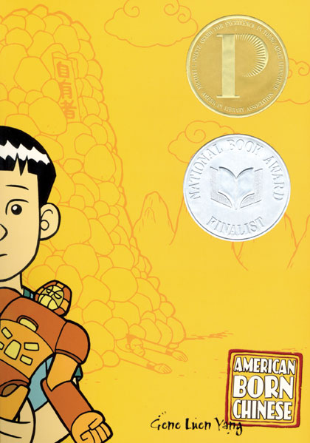
For next Monday, Finish American Born Chinese To think about:
Was the ending resolution to American Born Chinese satisfying to you as a reader? Why or why not?
Which image or series of images help convey the content or theme of ABC? In what way is this visual effective to you?

